Slide 1



JAIPUR ENGINEERING COLLEGE AND RESEARCH CENTRE
CRT TECHNICAL CLASS
of
SOFTWARE ENGINEERING
(SESSION 2023 -2024)
By:
Madhu Choudhary
Asst. Prof., Dept. of CSE
JECRC, Jaipur
1

Slide 2
VISION AND MISSION OF INSTITUTE
VISION
To become renowned centre of outcome based learning and work towards academic, professional, cultural and social enrichments of the lives of individual and communities”
MISSION
1. Focus on evaluation of learning outcomes and motivate students to inculcate research aptitude by project based learning.
2. Identify areas of focus and provide platform to gain knowledge and solutions based on informed perception of Indian, regional and global needs.
3. Offer opportunities for interaction between academia and industry.
4. Develop human potential to its fullest extent so that intellectually capable and imaginatively gifted leaders can emerge in a range of professions.
1

Slide 3
VISION AND MISSION OF DEPARTMENT
VISION
To become renowned Centre of excellence in computer science and engineering and make competent engineers & professionals with high ethical values prepared for lifelong learning.
MISSION
M1: To impart outcome based education for emerging technologies in the field of computer science and engineering.
M2: To provide opportunities for interaction between academia and industry.
M3: To provide platform for lifelong learning by accepting the change in technologies
M4: To develop aptitude of fulfilling social responsibilities.
1

Slide 4
CONTENTS (TO BE COVERED) IN TECHNICAL CLASS - 1
WHAT IS SOFTWARE
TYPES OF SOFTWARE PRODUCTS
SOFTWARE ENGINEERING DEFINITION
IMPORTANCE OF SOFTWARE ENGINEERING
FAQ ABOUT SOFTWARE ENGINEERING
ESSENTIAL ATTRIBUTES OF GOOD SOFTWARE
DEFINITION OF SOFTWARE PROCESS
PROCESS FLOW
TYPES OF SOFTWARE PROCESS MODELS
1

Slide 5
CONTENTS (TO BE COVERED) IN TECHNICAL CLASS - 2
AGILE PROCESS MODEL
SOFTWARE REQUIREMENT
TYPES OF REQUIREMENTS
REQUIREMENT ANALYSIS TASKS
SRS (SOFTWARE REQUIREMENTS SPECIFICATION)
PURPOSE AND CHARACTERISTICS OF GOOD SRS
DATA DICTIONARY
DATA MODELING
CARDINAL ITY AND MODALITY RELATIONSHIP
ER DIAGRAM
ER DIAGRAM – ENTITY & ATTRIBUTES
ER DIAGRAM – TYPES OF ATTRIBUTES
1

Slide 6
CONTENTS (TO BE COVERED) IN TECHNICAL CLASS - 2
FUNCTION MODELING
DFD (DATA FLOW DIAGRAM)
DFD SYMBOLS &NOTATION
LEVELS OF DFD
0 – LEVEL DFD
1 – LEVEL DFD
2 – LEVEL DFD
TYPES OF DFD – LOGICAL DFD
TYPES OF DFD – PHYSICAL DFD
1

Slide 7
WHAT IS SOFTWARE?
The product that software professionals build and then support over the long term.
Software encompasses:
(1) instructions (computer programs) that when executed provide desired features, function, and performance;
(2) data structures that enable the programs to adequately store and manipulate information and
(3) documentation that describes the operation and use of the programs.
1

Slide 8
TYPES OF SOFTWARE PRODUCTS
Generic products
Stand-alone systems that are marketed and sold to any customer who wishes to buy them.
Examples – PC software such as editing, graphics programs, project management tools; CAD software; software for specific markets such as appointments systems for dentists.
Customized products
Software that is commissioned by a specific customer to meet their own needs.
Examples – embedded control systems, air traffic control software, traffic monitoring systems.
1

Slide 9
SOFTWARE ENGINEERING DEFINITION
The IEEE definition:
Software Engineering: The application of a systematic, disciplined, quantifiable approach to the development, operation, and maintenance of software; that is, the application of engineering to software.
The seminal definition:
[Software engineering is] the establishment and use of sound engineering principles in order to obtain economically software that is reliable and works efficiently on real machines.
.
1

Slide 10
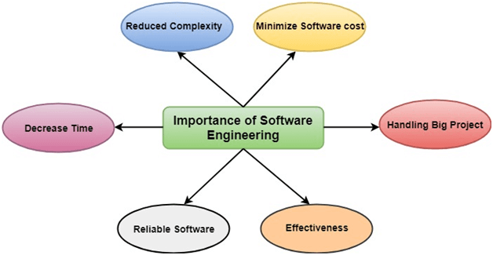
IMPORTANCE OF SOFTWARE ENGINEERING
More and more, individuals and society rely on advanced software systems. We need to be able to produce reliable and trustworthy systems economically and quickly.
It is usually cheaper, in the long run, to use software engineering methods and techniques for software systems rather than just write the programs as if it was a personal programming project.
1

Slide 11
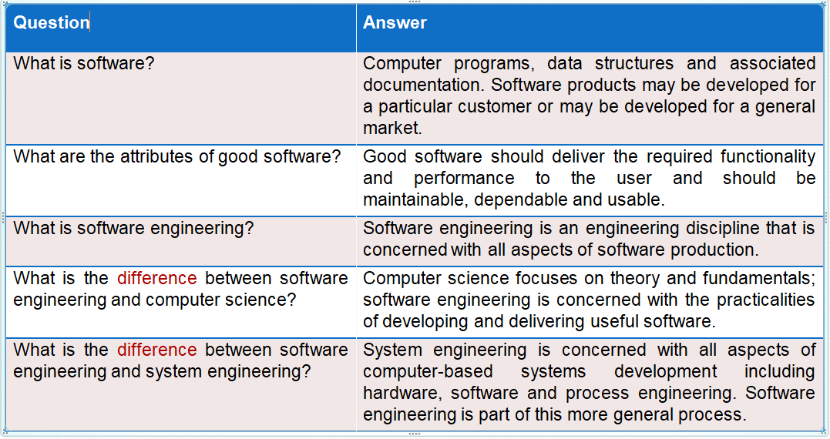
FAQ ABOUT SOFTWARE ENGINEERING
1

Slide 12
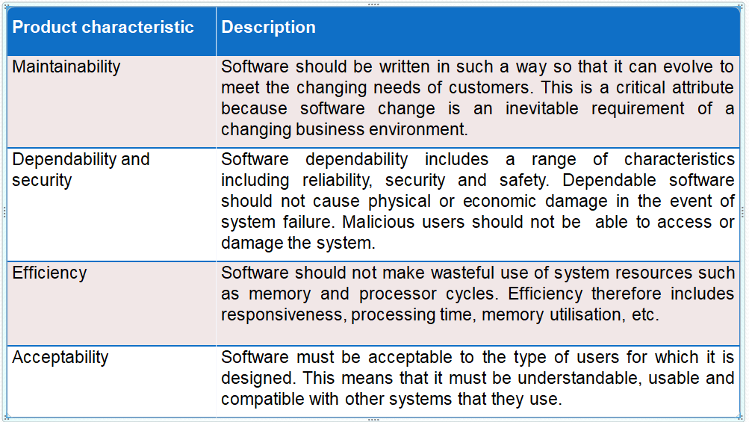
ESSENTIAL ATTRIBUTES OF GOOD SOFTWARE
1

Slide 13
DEFINITION OF SOFTWARE PROCESS
A framework for the activities, actions, and tasks that are required to build high-quality software.
SP defines the approach that is taken as software is engineered.
Is not equal to software engineering, which also encompasses technologies that populate the process– technical methods and automated tools.
1

Slide 14
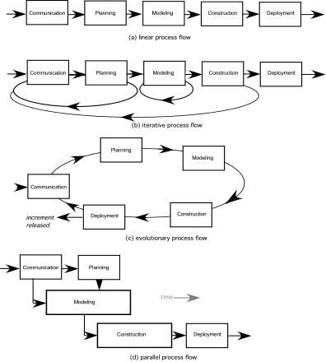
PROCESS FLOW
1

Slide 15
PROCESS FLOW Cont…
Linear process flow executes each of the five activities in sequence.
An iterative process flow repeats one or more of the activities before proceeding to the next.
An evolutionary process flow executes the activities in a circular manner. Each circuit leads to a more complete version of the software.
A parallel process flow executes one or more activities in parallel with other activities ( modeling for one aspect of the software in parallel with construction of another aspect of the software.
1

Slide 16
TYPES OF SOFTWARE PROCESS MODELS
SDLC (Software Development Life Cycle) – Parent of all software process Models
Linear Sequential Models
Waterfall Model
V - Model
2. Incremental Models
The Incremental Model
The RAD Model
3. Evolutionary Process Models
Prototyping Model
The Spiral Model
1

Slide 17
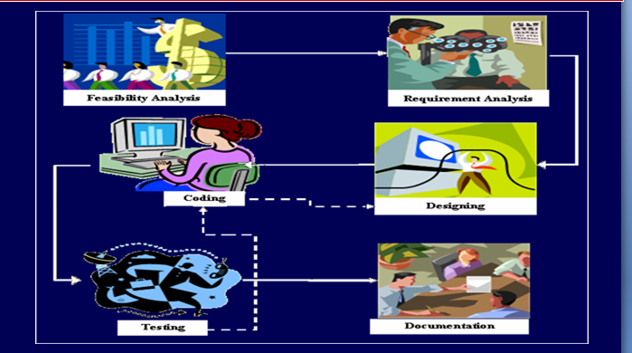
SDLC (SOFTWARE DEVELOPMENT LIFE - CYCLE MODELS)
1

Slide 18
THE WATERFALL MODEL
It is the oldest paradigm for SE. When requirements are well defined and reasonably stable, it leads to a linear fashion.
(problems: 1. rarely linear, iteration needed. 2. hard to state all requirements explicitly. Blocking state. 3. code will not be released until very late.)
The classic life cycle suggests a systematic, sequential approach to software development.
1

Slide 19
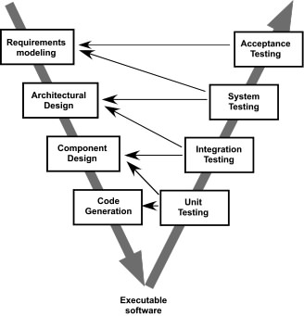
V- MODEL
A variation of waterfall model depicts the relationship of quality assurance actions to the actions associated with communication, modeling and early code construction activates.
Team first moves down the left side of the V to refine the problem requirements. Once code is generated, the team moves up the right side of the V, performing a series of tests that validate each of the models created as the team moved down the left side.
1

Slide 20
VERIFICATION AND VALIDATION
Verification and Validation is the process of investigating that a software system satisfies specifications and standards and it fulfills the required purpose. Barry Boehm described verification and validation as the following:
Verification: Are we building the product right?
Validation: Are we building the right product?
Verification: Verification is the process of checking that a software achieves its goal without any bugs. It is the process to ensure whether the product that is developed is right or not. It verifies whether the developed product fulfills the requirements that we have.
Verification is Static Testing. Activities involved in verification:
Inspections
Reviews
Walkthroughs
Desk-checking
1

Slide 21
CONT...
Validation: Validation is the process of checking whether the software product is up to the mark or in other words product has high level requirements. It is the process of checking the validation of product i.e. it checks what we are developing is the right product. it is validation of actual and expected product.
Validation is the Dynamic Testing.
Activities involved in validation:
Black box testing
White box testing
Unit testing
Integration testing
1

Slide 22
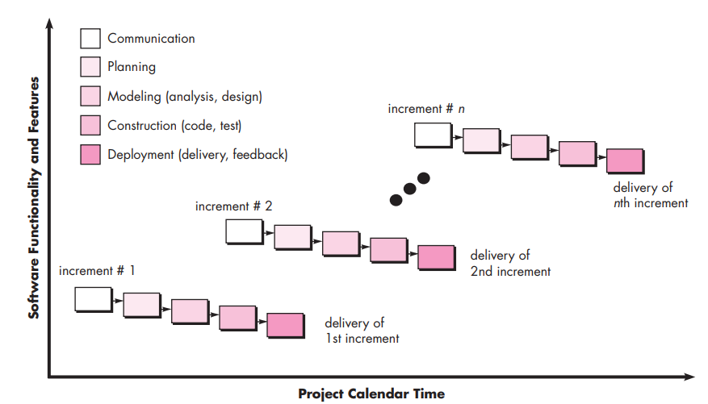
THE INCREMENTAL MODEL
1

Slide 23
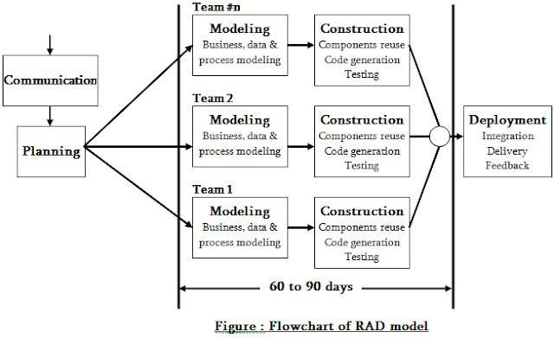
THE RAD (RAPID APPLICATION DEVELOPMENT) MODEL
1

Slide 24
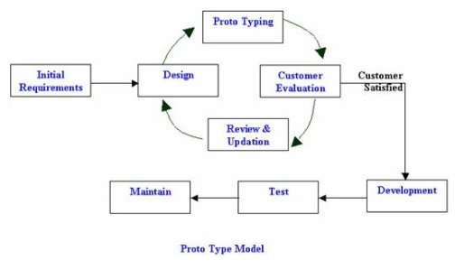
PROTOTYPING MODEL
1

Slide 25
SPIRAL MODEL
1

Slide 26
AGILE PROCESS MODEL
Agile is a time-bound, iterative approach to software delivery that builds software incrementally from the start of the project, instead of trying to deliver all at once.
The Agile model was primarily designed to help a project to adapt to change requests quickly.
So, the main aim of the Agile model is to facilitate quick project completion. To accomplish this task agility is required.
Agility is achieved by fitting the process to the project, removing activities that may not be essential for a specific project. Also, anything that is wastage of time and effort is avoided.
1

Slide 27
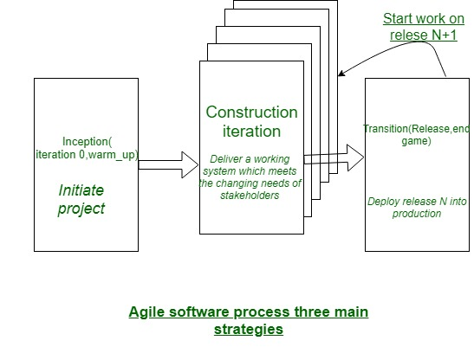
AGILE PROCESS MODEL CONT...
1

Slide 28
SOFTWARE REQUIREMENT
The software requirements are description of features and functionalities of the target system. Requirements convey the expectations of users from the software product.
The requirements can be obvious or hidden, known or unknown, expected or unexpected from client’s point of view.
Requirement Engineering
The process to gather the software requirements from client, analyze and document them is known as requirement engineering.
The goal of requirement engineering is to develop and maintain sophisticated and descriptive ‘System Requirements Specification’ document.
1

Slide 29
TYPES OF REQUIREMENTS
Functional Requirements: These are the requirements that the end user specifically demands as basic facilities that the system should offer.
All these functionalities need to be necessarily incorporated into the system as a part of the contract.
Non-functional requirements: These are basically the quality constraints that the system must satisfy according to the project contract. They basically deal with issues like:
Portability, Security, Maintainability, Reliability, Scalability, Performance, Reusability & Flexibility
1

Slide 30
REQUIREMENT ANALYSIS TASKS
The requirement analysis process is accomplished through the execution of seven distinct tasks:
Inception
Elicitation
Elaboration
Negotiation
Specification
Validation
Management
1

Slide 31
SRS (SOFTWARE REQUIREMENTS SPECIFICATION)
SRS is the official statement of what the system developers should implement.
SRS is a complete description of the behavior of the system to be developed.
SRS should include both a definition of user requirements and a specification of the system requirements.
The SRS fully describes what the software will do and how it will be expected to perform.
1

Slide 32
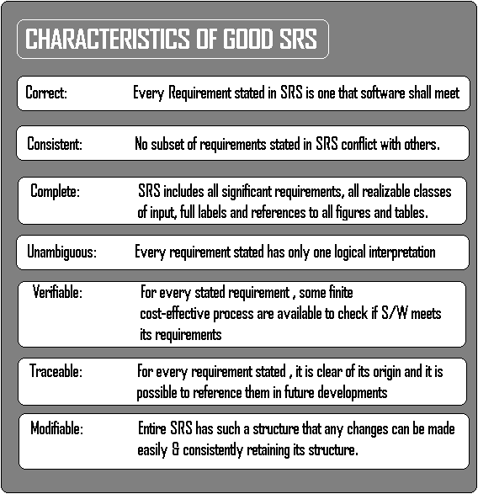
PURPOSE AND CHARACTERISTICS OF GOOD SRS
The SRS precisely defines the software product that will be built.
SRS used to know all the requirements for the software development and thus that will help in designing the software.
It provides feedback to the customer.
1

Slide 33
DATA DICTIONARY
A data dictionary is a file or a set of files that includes a database's metadata. The data dictionary hold records about other objects in the database, such as data ownership, data relationships to other objects, and other data. The data dictionary is an essential component of any relational database. Ironically, because of its importance, it is invisible to most database users. Typically, only database administrators interact with the data dictionary.
The data dictionary, in general, includes information about the following:
Name of the data item, Aliases, Description/purpose, Related data items, Range of values, Data structure definition/Forms
1

Slide 34
DATA DICTIONARY EXAMPLE
Field Name | Data Type | Field Size for display | Description | Example
Employee Number | Integer | 10 | Unique ID of each employee | 1645000001
Name | Text | 20 | Name of the employee | David Heston
Date of Birth | Date/Time | 10 | DOB of Employee | 08/03/1995
Phone Number | Integer | 10 | Phone number of employee | 6583648648
1

Slide 35
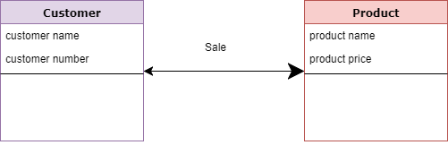
DATA MODELING
Data modeling is a technique for defining business requirements for a database. It is sometimes called database modeling because a data model is eventually implemented in a database.
A data modelling consists of three interrelated piece of information,
Entity - A real-world thing
Attribute - Characteristics or properties of an entity
Relationship - Dependency or association between two entities
1

Slide 36
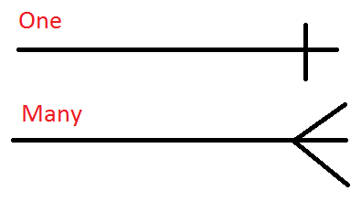
CARDINAL ITY AND MODALITY RELATIONSHIP
Cardinality describes that a data model must be able to represent the number of occurrences of an object/s in a given relationship. It can be expressed in the pattern of “one” or “many”.
For associating two objects, any of the three cardinal relations can be made.
One-to-one – In this relation, the occurrence of object “x” can relate to only one occurrence of object “y” and vice-versa.
One-to-many – One occurrence of object “x” can relate to multiple occurrences of the object “y”. However, the object “y” can only relate to a single occurrence of “x”.
Many-to-many – Multiple occurrences of object “x” can relate to multiple occurrences of object “y” and vice-versa.
1

Slide 37
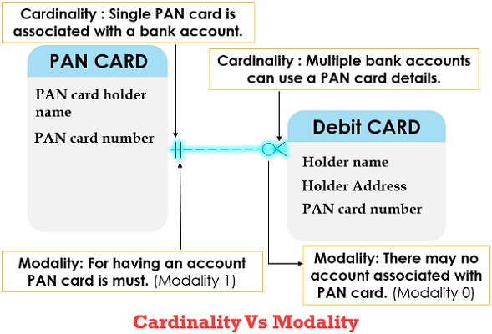
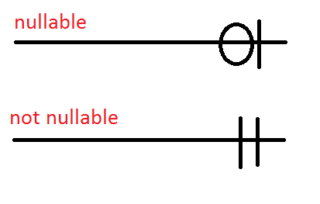
CARDINAL ITY AND MODALITY RELATIONSHIP CONT…
Modality:- Its value is computed as “o” when there is no requirement for the relationship to occur or if the relationship is optional.
The modality value is “1” if there is a compulsion for the occurrence of a relationship. In simple words, it describes whether a relationship between two or more entities is even required or not.
1

Slide 38
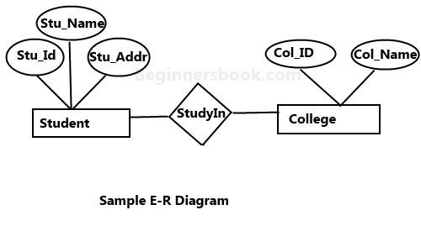
ER DIAGRAM
An Entity–relationship model (ER model) describes the structure of a database with the help of a diagram, which is known as Entity Relationship Diagram (ER Diagram). An ER model is a design or blueprint of a database that can later be implemented as a database. The main components of E-R model are: entity set, attribute and relationship set.
1

Slide 39
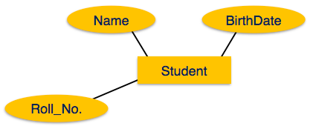
ER DIAGRAM – ENTITY & ATTRIBUTES
Entity - Entities are represented by means of rectangles. Rectangles are named with the entity set they represent.
Attributes - Attributes are the properties of entities. Attributes are represented by means of ellipses. Every ellipse represents one attribute and is directly connected to its entity (rectangle).
1

Slide 40
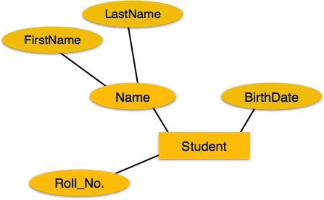
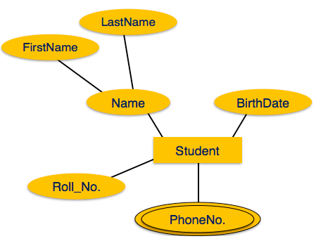
ER DIAGRAM – TYPES OF ATTRIBUTES
Composite Attribute
Multivalued Attribute
1

Slide 41
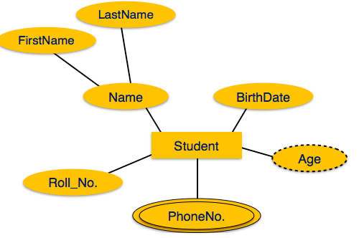
ER DIAGRAM – TYPES OF ATTRIBUTES CONT…
3. Derived attributes are depicted by dashed ellipse.
1

Slide 42
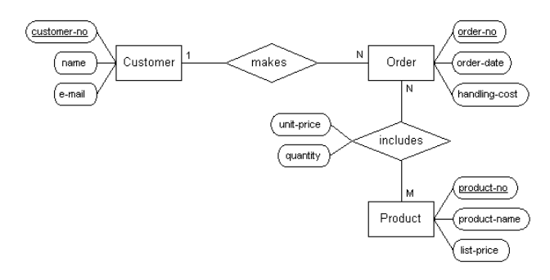
ER – DIAGRAM EXAMPLE
1

Slide 43
FUNCTION MODELING
In software engineering a function model or functional model is a structured representation of the functions (activities, actions, processes, operations) within the modeled system or subject area.
A function model is a graphical representation of an enterprise's function within a defined scope.
The purposes of the function model are to describe the functions and processes
Function modeling is done via DFD.
1

Slide 44
DFD (DATA FLOW DIAGRAM)
A Data Flow Diagram is a graphical representation of flow of data through information system.
DFD can be used to visualize a data processing.
DFD shows what kind of data will be input to the system and what data is received as the output.
Focus on the movement of data between external entities and processes, and between processes and data stores.
1

Slide 45
WHY DFD?
DFD has of been used due to the following reasons:
Provides an overview of-
What data a system processes
What transformations are performed
What data are stored
What results are produced and where they flow
Graphical nature makes it a good communication tool between-
User and analyst
Analyst and System designer
1

Slide 46
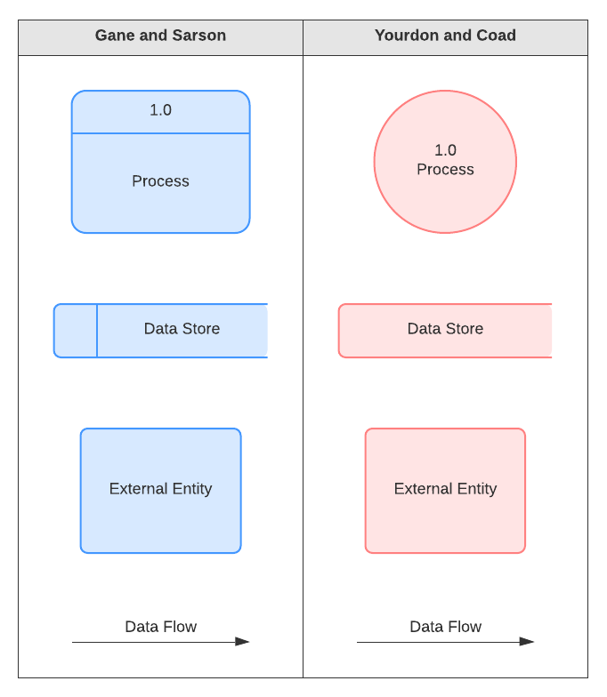
DFD SYMBOLS &NOTATION
External Entity - People or organizations that send data into the system or receive data from the system.
Process - Models what happens to the data i.e. transforms incoming data into outgoing data.
Data Store - Represents permanent data that is used by the system.
Data Flow - Models the actual flow of the data between the other elements.
1

Slide 47
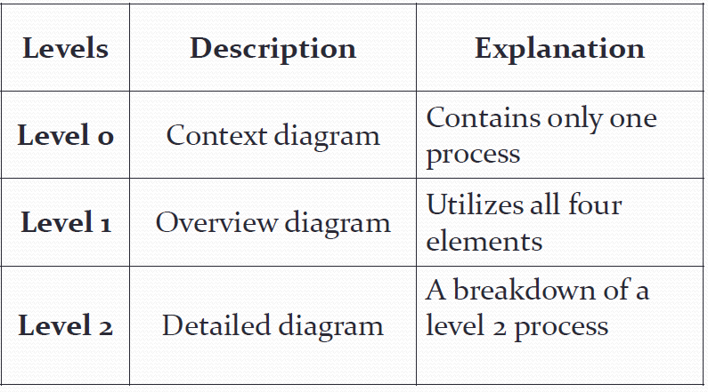
LEVELS OF DFD
There is no rule as to how many levels of DFD that can be used.
1

Slide 48
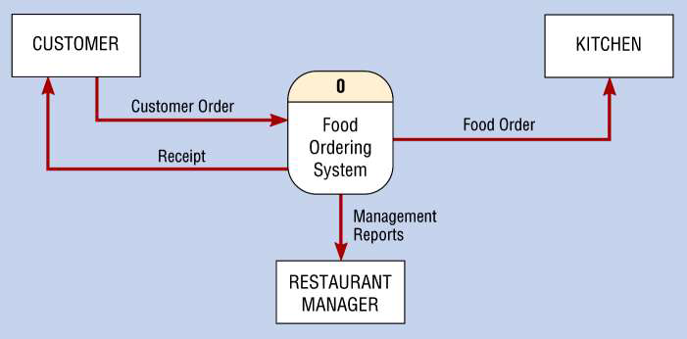
0 – LEVEL DFD
1 process represents the entire system.
Data arrows show input and output.
Data Stores NOT shown. They are within the system.
1

Slide 49
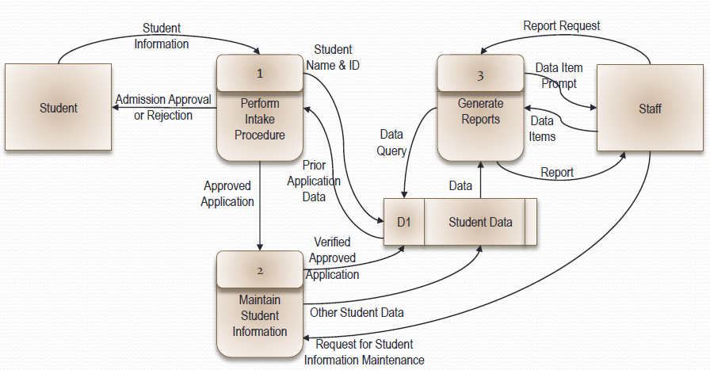
1 – LEVEL DFD
The SRS precisely defines the software product that will be built.
Level 1 DFD, must balance with the context diagram it describes.
Input going into a process are different from outputs leaving the process.
Data stores are first shown at this level.
1

Slide 50
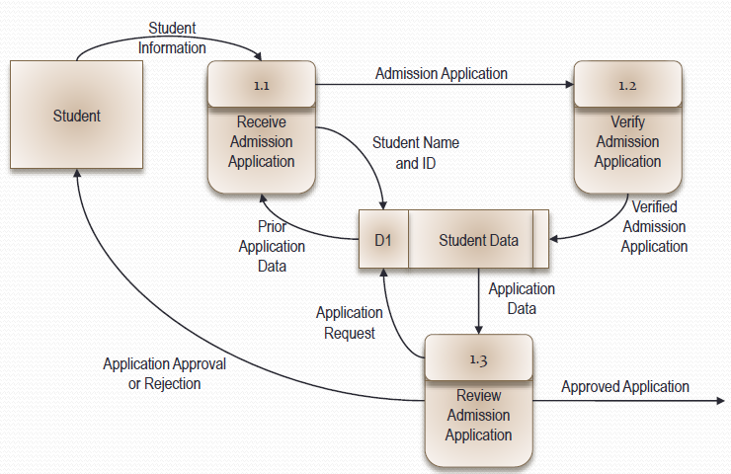
2 – LEVEL DFD: Process 1, Perform Intake Procedure
Level 2 DFD must balance with the Level 1 it describes.
Input going into a process are different from outputs leaving the process.
Continue to show data stores.
1

Slide 51
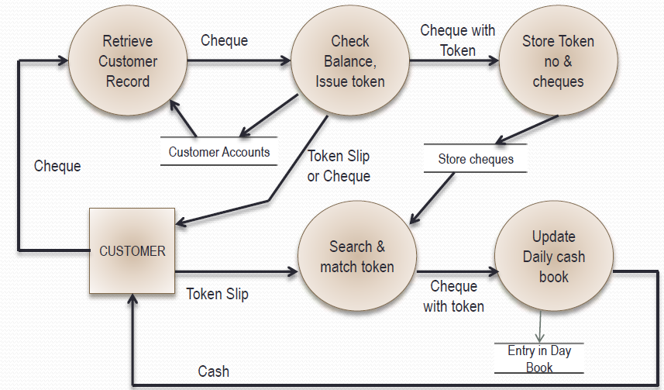
TYPES OF DFD – LOGICAL DFD
A logical data flow diagram focuses on the business and how the business operates. It is not concerned with how the system will be constructed.
We can ignore implementation specifics such as, computer configuration, data storage technology, communication or message passing methods by focusing on the functions performed by the system, such as, data collection, data to information transformation and information reporting.
Logical DFD for Cheque Encashment Ex.
1

Slide 52
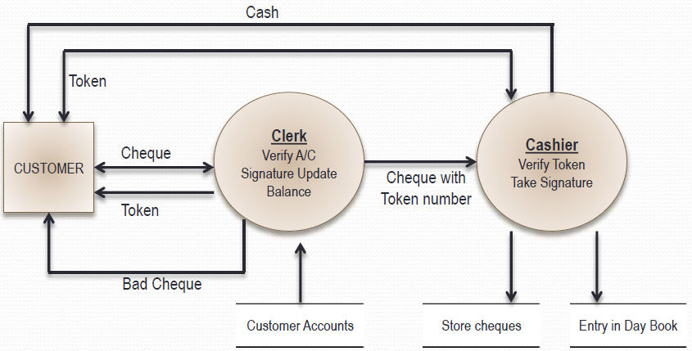
TYPES OF DFD – PHYSICAL DFD
A physical data flow diagram shows how the system will be implemented, including the hardware, software, files, and people in the system. It is developed such that the processes described in the logical data flow diagrams are implemented correctly to achieve the goal of the business.
Physical DFD for Cheque Encashment
1

Slide 53
DFD MCQ’s
1. In a DFD external entities are represented by a
a. Rectangle
b. Ellipse
c. Diamond shaped box
d. Circle
2. External Entities may be a
a. Source of input data only
b. Source of input data or destination of results
c. Destination of results only
d. Repository of data
3. A data store in a DFD represents
a. A sequential file c. A repository of data
b. A disk store d. A random access memory
1

Slide 54
DFD MCQ’s CONT...
4. By an external entity we mean a
a. Unit outside the system being designed which can be controlled by an analyst
b. Unit outside the system whose behavior is independent of the system being designed
c. A unit external to the system being designed
d. A unit which is not part of DFD
5. A data flow can
a. Only enter a data store
b. Only leave a data store
c. Enter or leave a data store
d. Either enter or leave a data store but not both
6. A circle in a DFD represents
a. A data store b. A an external entity
c. A process d. An input unit
1

Slide 55



Madhu Choudhary(Asst. Prof., CSE), JECRC, JAIPUR

